Slide 1
Exception Handling in C++

Slide 2
Introduction
Exceptions
  Indicate problems that occur during a program’s execution
  Occur infrequently
Exception handling
  Can resolve exceptions
    Allow a program to continue executing or
    Notify the user of the problem and
    Terminate the program in a controlled manner
  Makes programs robust and fault-tolerant

Slide 3
Exception Handling in C++
A standard mechanism for processing errors
  Especially important when working on a project with a large team of programmers
C++ exception handling is much like Java’s
Java’s exception handling is much like C++

Slide 4
Traditional Exception Handling
Intermixing program and error-handling logic
  Pseudocode outline
  Perform a task
  If the preceding task did not execute correctly
  Perform error processing
  Perform next task
  If the preceding task did not execute correctly
  Perform error processing
  …
Makes the program difficult to read, modify, maintain and debug
Impacts performance

Slide 5
Fundamental Philosophy (continued)
Remove error-handling code from the program execution’s “main line”
Programmers can handle any exceptions they choose
  All exceptions
  All exceptions of a certain type
  All exceptions of a group of related types

Slide 6
Fundamental Philosophy (continued)
Programs can
  Recover from exceptions
  Hide exceptions
  Pass exceptions up the “chain of command”
  Ignore certain exceptions and let someone else handle them

Slide 7
Fundamental Philosophy (continued)
An exception is a class
    Usually derived from one of the system’s exception base classes
If an exceptional or error situation occurs, program throws an object of that class
    Object crawls up the call stack
A calling program can choose to catch exceptions of certain classes
    Take action based on the exception object

Slide 8
Types of Error
Syntax (Compile time)
Logical
Runtime

Slide 9
Categories of Error
Synchronous:
  With in the control of program.
Asynchronous
  Outside the control of program.
  Like: memory, keyboard, mouse or any other hardware failure.

Slide 10
Exception handling blocks/mechanism
TRY: Detects the exception
CATCH: Catches the exception and handles the exception.
THROW: Function that causes the exception

Slide 11
Syntax
try {
:
:
:
throw( exception);
:
:
}
Catch( type arguments){
}

Slide 12
Example
int main(){
int a, b, res;
Cout<<“Enter values of a and b :”;
Cin>> a >> b;
Res= a-b;
try{
if (res != 0)
{
cout<< “Result (a/res) =” << a / res << “\n”;
}
else
{
throw ( res );
}
}
catch (int i) {
cout<< “Eception caught” ;
} }

Slide 13
Class exception
The standard C++ base class for all exceptions
Provides derived classes with virtual function what
  Returns the exception’s stored error message

Slide 14
try Blocks
Keyword try followed by braces ({})
Should enclose
  Statements that might cause exceptions
  Statements that should be skipped in case of an exception

Slide 15
Software Engineering Observation
Exceptions may surface
  through explicitly mentioned code in a try block,
  through calls to other functions and
  through deeply nested function calls initiated by code in a try block.

Slide 16
Catch Handlers
Immediately follow a try block
  One or more catch handlers for each try block
Keyword catch
Exception parameter enclosed in parentheses
  Represents the type of exception to process
  Can provide an optional parameter name to interact with the caught exception object
Executes if exception parameter type matches the exception thrown in the try block
  Could be a base class of the thrown exception’s class

Slide 17
Catch Handlers (continued)
All other classes of exceptions
are not handled here
try {
// code to try
}
catch (exceptionClass1 &name1) {
// handle exceptions of exceptionClass1
}
catch (exceptionClass2 &name2) {
// handle exceptions of exceptionClass2
}
catch (exceptionClass3 &name3) {
// handle exceptions of exceptionClass3
}
...
/* code to execute if
no exception or
catch handler handled exception*/
catch clauses attempted
in order; first match wins!

Slide 18
Syntax
try {
// protected code
}
catch( ExceptionName e1 ) {
// catch block
}
catch( ExceptionName e2 ) {
// catch block
}
catch( ExceptionName eN ) {
// catch block
}

Slide 19
Common Programming Errors
Syntax error to place code between a try block and its corresponding catch handlers
Each catch handler can have only a single parameter
    Specifying a comma-separated list of exception parameters is a syntax error
Logic error to catch the same type in two different catch handlers following a single try block

Slide 20
Catch block to handle any type of exception
try {
// protected code
}
catch(...) {
// code to handle any exception
}
CS-2303, C-Term 2010

Slide 21
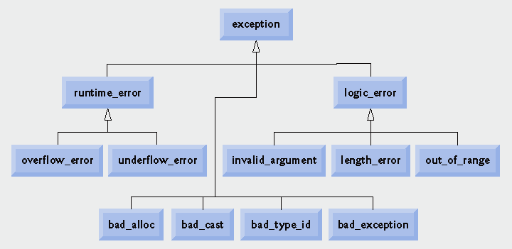
Standard Library exception classes.
range_error
domain_error

Slide 22
#include <iostream> #include <exception> using namespace std; struct MyException : public exception { const char * what () const throw () { return "C++ Exception";
} }; int main() { try { throw MyException();
} catch(MyException& e) { std::cout << "MyException caught" << std::endl; std::cout << e.what() << std::endl;
} catch( std::exception& e) { //Other errors }
}

